Slide 1
Rob Byrd Chief Enterprise Architect
Texas Association of Enterprise Architects Summit
Enterprise Architecture Findings
Aligning Information Technology Services to the Business Needs of the City…

Slide 2
Problem Statement
Information technology (IT) solution provider is unable to keep pace with the business needs (demand) for enterprise-wide capabilities
Understand enterprise-wide capabilities…
Capability: People, processes and technology delivering value for a specific purpose. The quality of being capable; to have the capacity or ability to do something, achieve specific outcomes, effects or declared goals and objectives

Slide 3
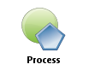
Managing Complexity
<<vision>>
Best Managed City
<<capability>>
Manage Infrastructure
<<capability>>
Clean Water
<<capability>>
Equal Opportunities
<<capability>>
Healthy Economy
<<capability>>
Safe Public
<<capability>>
Healthy Community
<<capability>>
Reliable Energy
<<capability>>
Mobile Community
Establish Goals
<<goal>>
Conserve Water Resources
<<goal>>
Integrate Case and Asset Management
<<goal>>
Sustain Environment
<<goal>>
Optimize Operations
<<goal>>
Increase Revenue
<<goal>>
Respond to Customer Needs
<<goal>>
Define Mobile User Processes

Slide 4
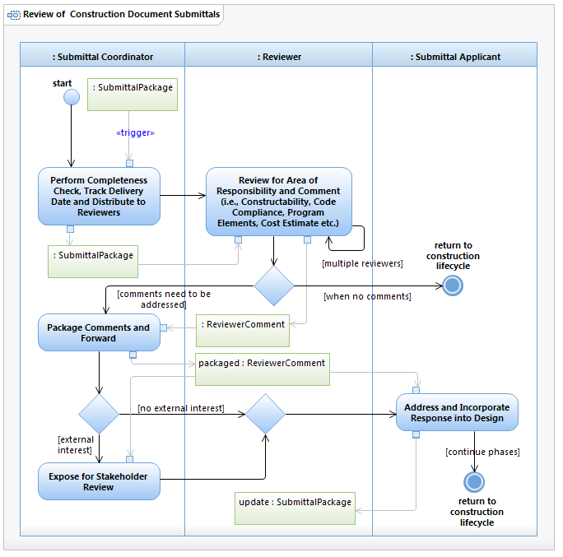
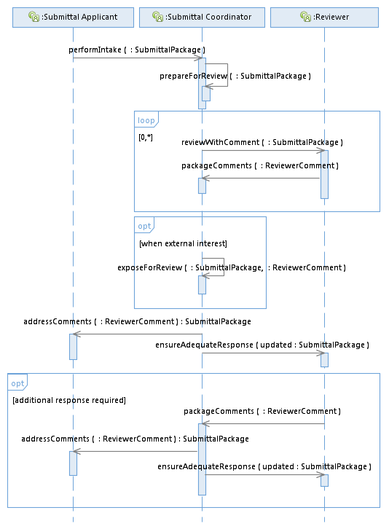

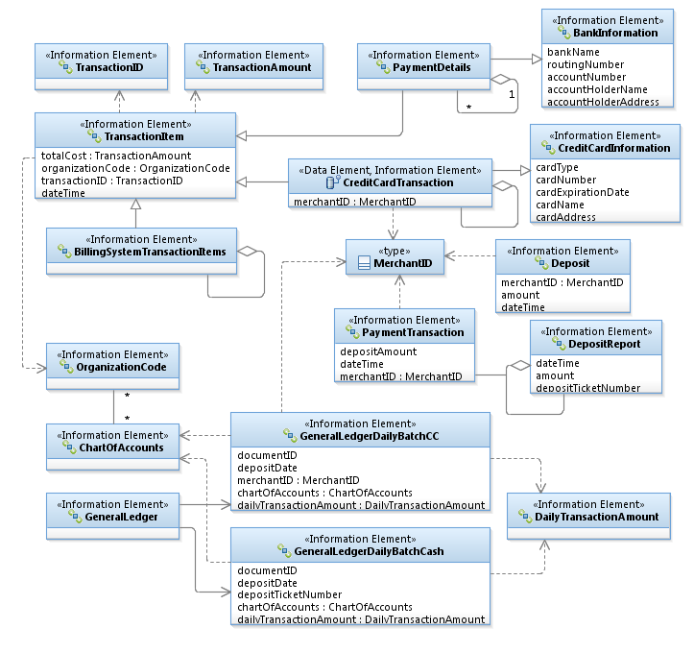
Managing Complexity
Process
Stakeholder developed!

Slide 5
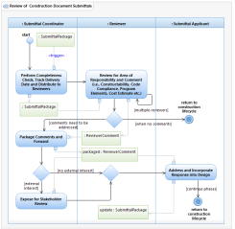
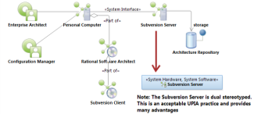
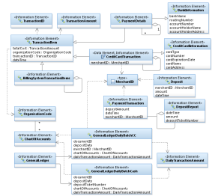
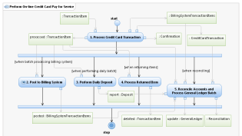
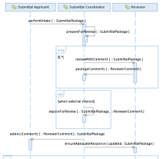
Identifying Common Opportunities
<<vision>>
Best Managed City
<<capability>>
Manage Infrastructure
<<capability>>
Clean Water
<<capability>>
Equal Opportunities
<<capability>>
Healthy Economy
Identify Common Capabilities
<<capability>>
Safe Public
<<capability>>
Healthy Community
<<capability>>
Reliable Energy
<<capability>>
Mobile Community
Identify Common Process
Goals Amplify Vision!
Identify Common Infrastructure
Top Down – Bottom Up
Identify Common Data
<<goal>>
Conserve Water Resources
<<goal>>
Integrate Case and Asset Management
<<goal>>
Sustain Environment
<<goal>>
Optimize Operations
Identify Common Goals
<<goal>>
Increase Revenue
<<goal>>
Respond to Customer Needs
<<goal>>
Define Mobile User Processes

Slide 6
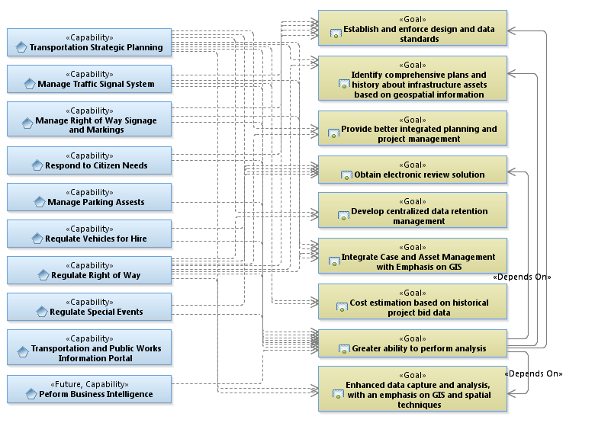
Business Needs Analysis
Value Proposition…

Slide 7
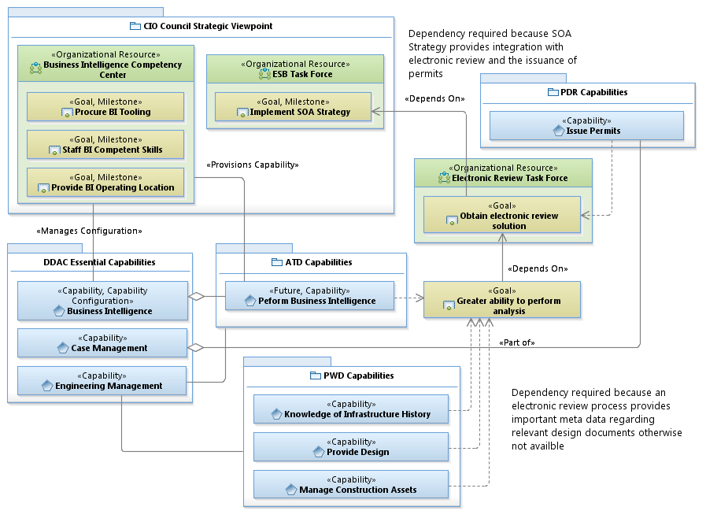
Goal Dependency

Slide 8
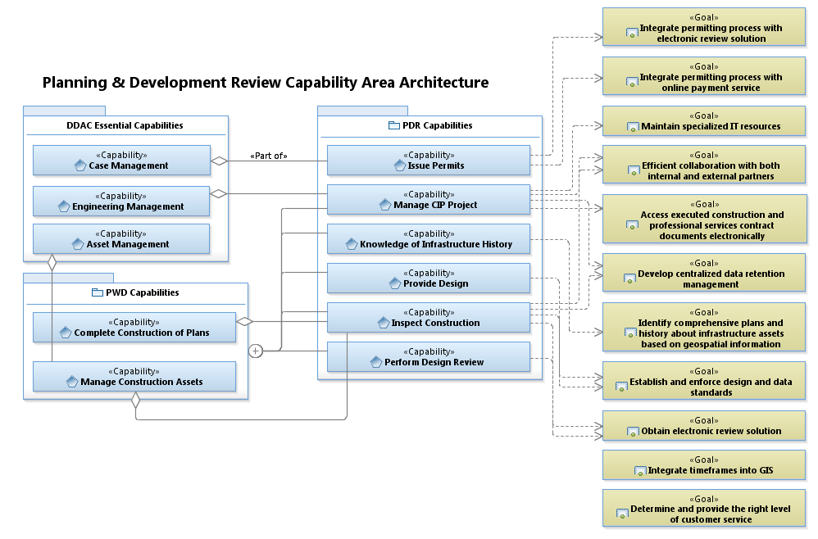
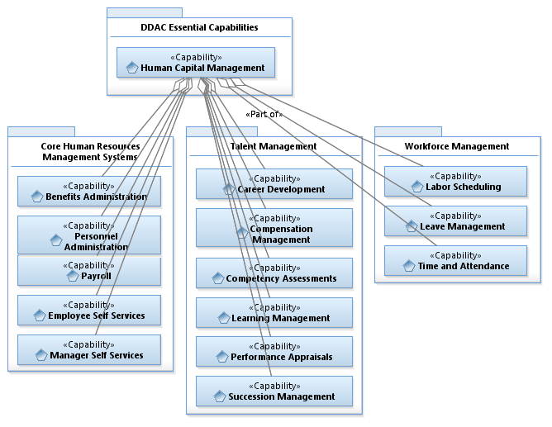
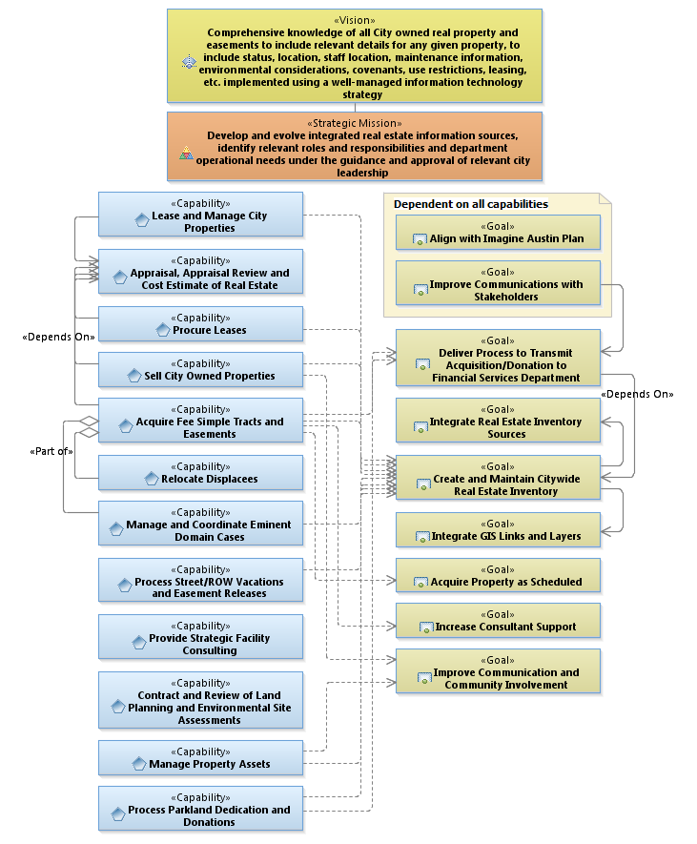
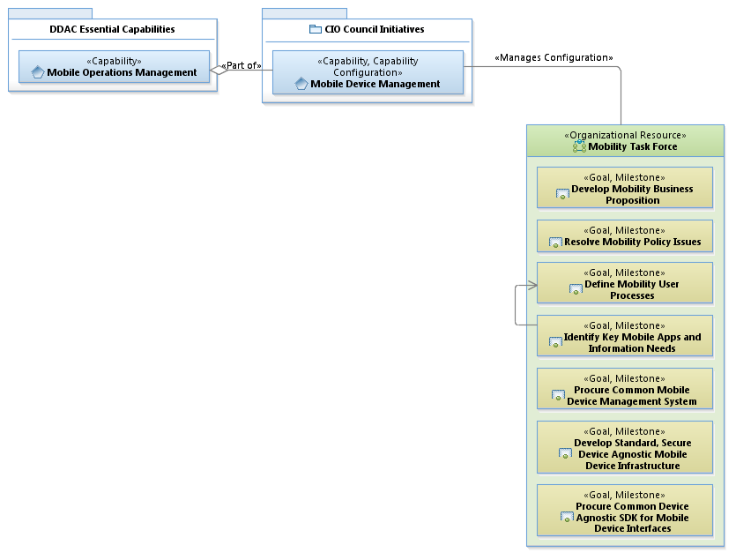
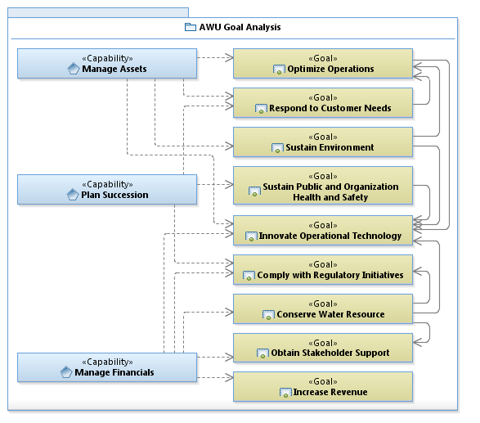
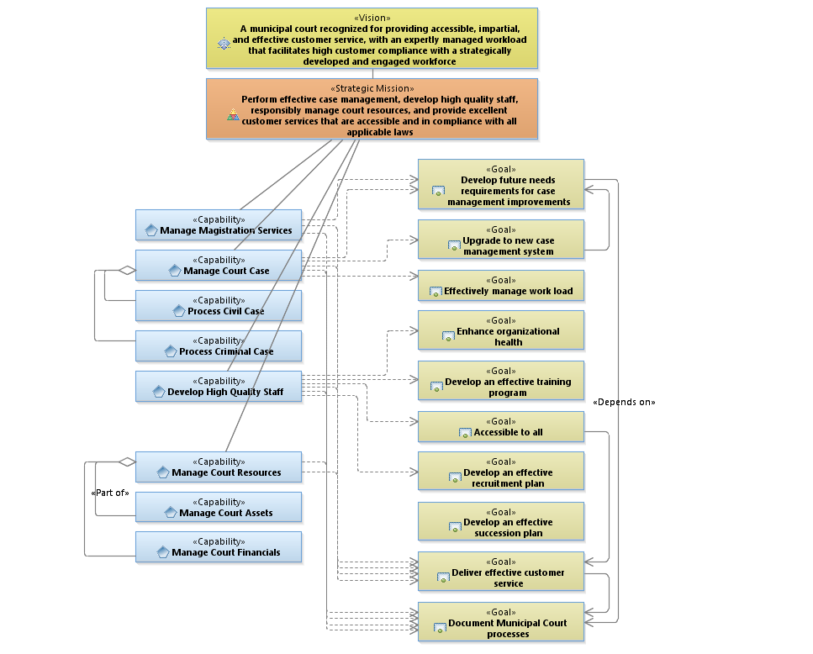
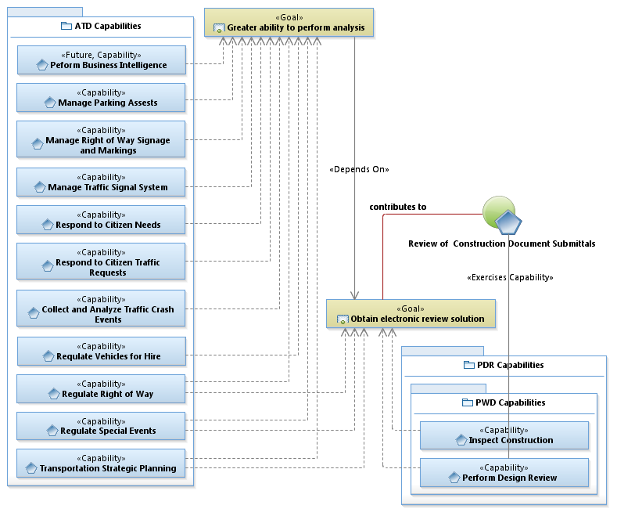
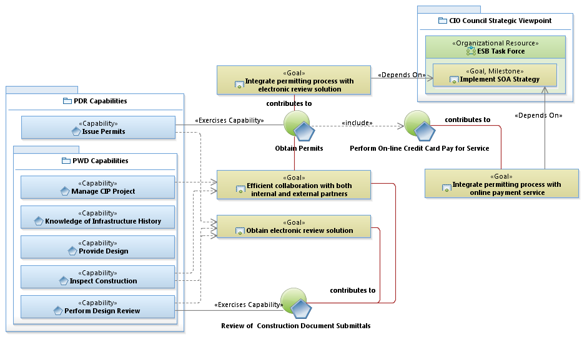
Business Strategic Viewpoints (Capabilities and Goals)

Slide 9
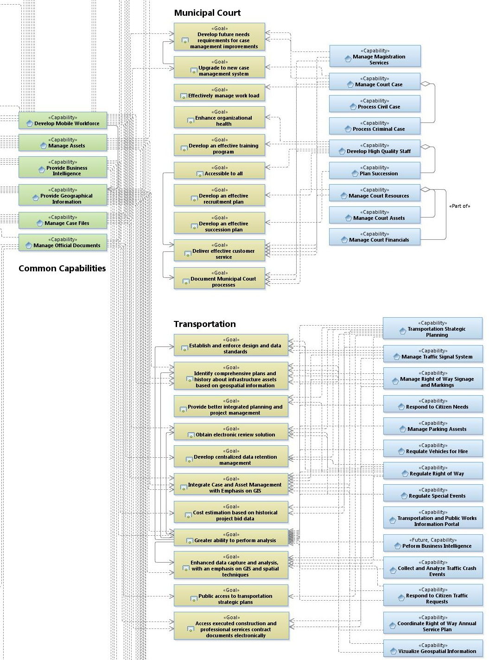
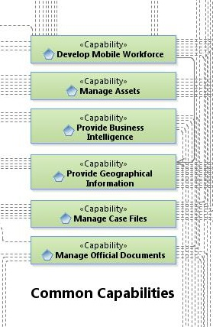
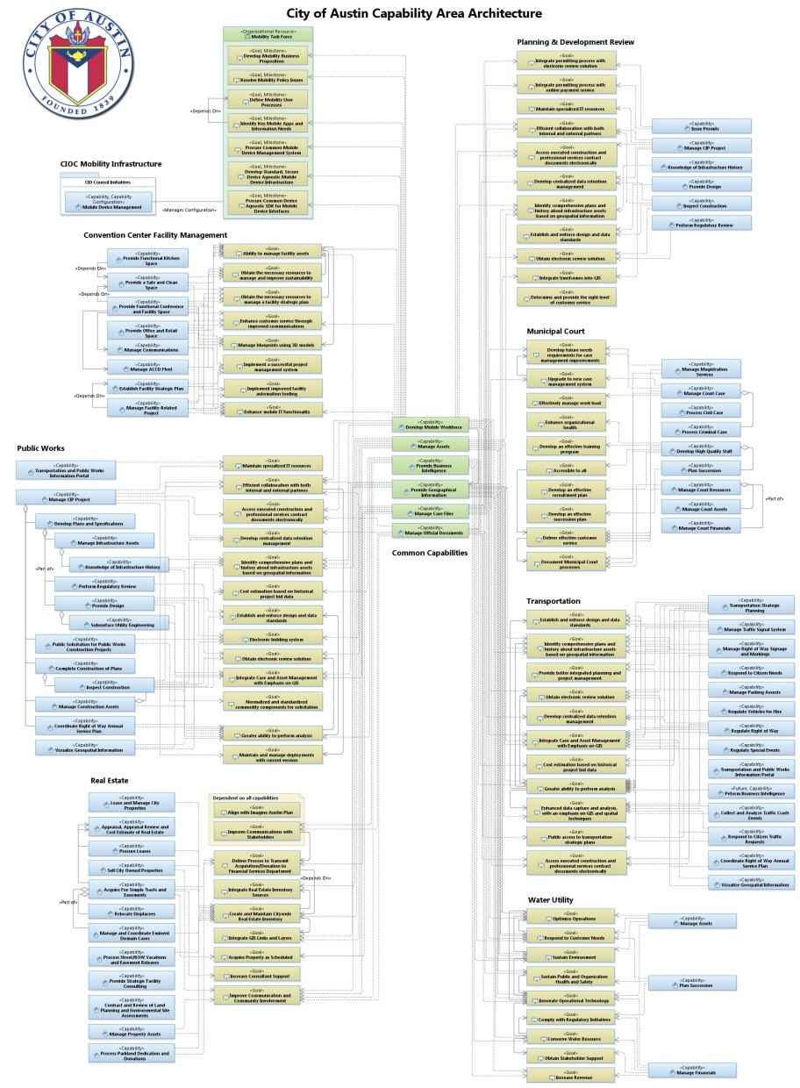
Business Strategic Viewpoints (Capabilities and Goals)
Business Capabilities
Business Goals

Slide 10
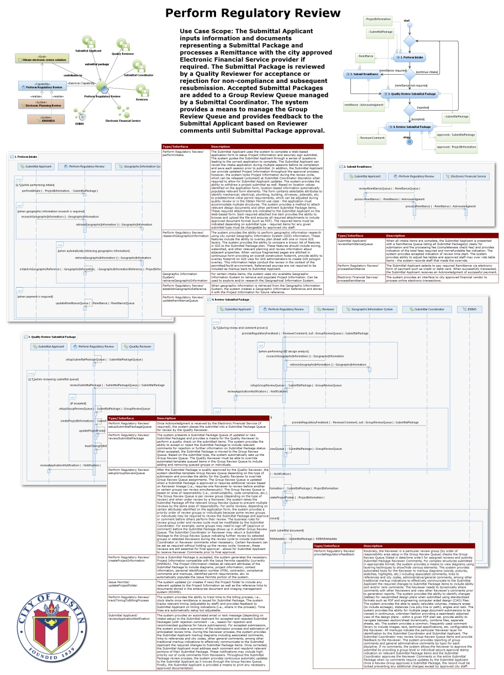
Aligning IT Services to Business Needs
Business Capabilities
Business Goals

Slide 11
Goal Realization – EA Sequencing Plan
Realize the Goals
EA Sequencing Plan
Integrates the business need
Defines the customer experience
Capture the business rules
Provides ‘contract’ with the stakeholder

Slide 12
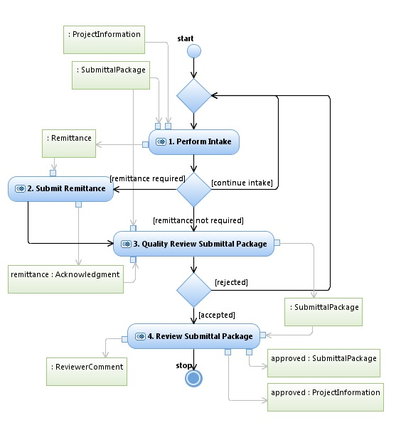
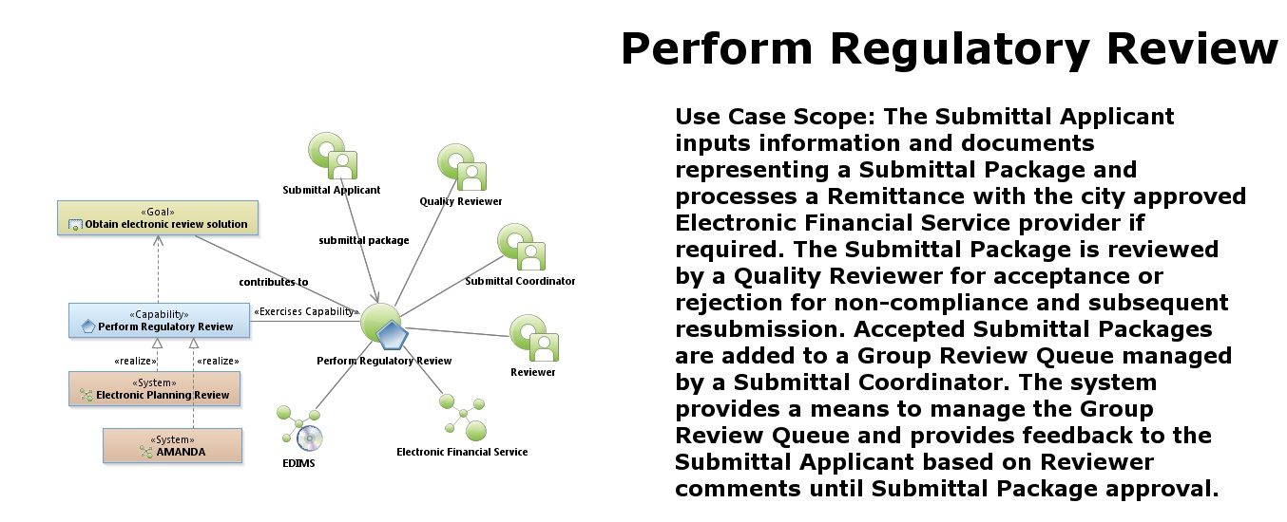
EA Sequencing Plan
Understand Process…
Common Capability - Common Goal Develop scope…

Slide 13
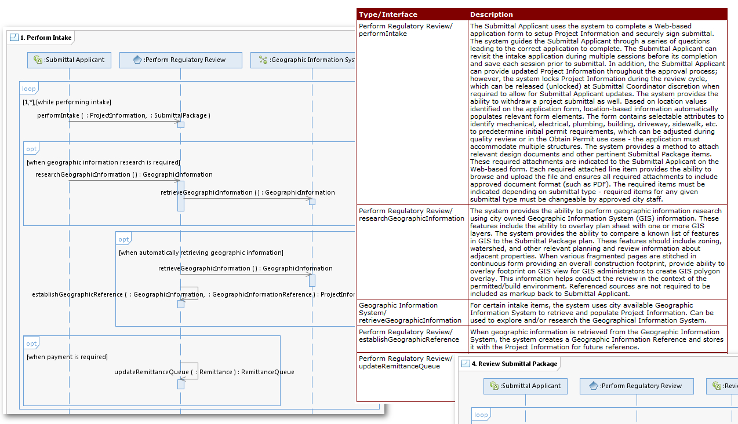
Define the Customer Experience
Integrate Business Need…

Slide 14
Develop IT Business Need Strategy
Increase technical staff to keep pace with demand
Build user vetted architectures before implementing solutions
Integrate with Manage Case Files and Provide Geographical Information
AWU mobility pilot – asset and work order management – learn from it!
Explore user serviceable tools
Deploy Mobile Device Management
Exploit architecture to identify interface needs
Understand business reporting needs and establish data warehouse(s)
Exploit extract, transform, and load (ETL) technologies
Reduce impediments to accessing information
Share information with citizens
Exploit enterprise service bus (ESB) to better serve a Mobile Workforce
Share services with other government agencies
Increase technical staff to keep pace with demand
Explore alternative solutions
Build user vetted architectures before implementing solutions
Integrate with Manage Assets and Provide Geographical Information
Employ application integration methods
Access information using mobile devices
Standardize employment approach
IT Services…

Slide 15

EA Derived IT Strategy
Vision | Recognized business partner One City IT | Imagine Austin E A20 - Improve government efficiency through technology (software and hardware) investments and by developing and retaining information technology staff
Principles | Demonstrate value as business partner Employ Enterprise Architecture in governance Integrate strategic plans Maximize use of common information system | Identify enterprise shared service opportunities Share common IT staff Identify reusable technology assets Provide business continuity
Common Capability | IT Imperatives | Future State
Develop Mobile Workforce Manage Assets Provide Business Intelligence Provide Geographic Information Manage Case Files Manage Official Documents | Build an end-to-end service model using Enterprise Architecture processes to align IT services to business needs Align IT services with required competencies – repurpose staff to increase business solutions – train to fill gaps Increase technical staff for high-value enterprise tools such as Maximo and Amanda Move toward mobile solutions Share services, not just data, with partnering agencies Integrate GIS with mobile and enterprise applications Mature service-oriented architecture using enterprise service bus (ESB) Exploit extract, translate and load (ETL) tooling for data warehousing and business intelligence – remove impediments to information | Empowered leadership and citizens Service-oriented provider Capable and competent staff Established systems of record Cross-department integration Policies, standards and practices Conduct business online Work anywhere online Open access to information

Slide 16
Next Steps
Analyze IT service delivery model and reengineer to emphasize Common Capabilities in the form of IT Services
Look for repurposing opportunities – share IT resources when appropriate – train where needed
Establish IT service managers responsible for Common Capabilities delivery
Clearly define IT service manager role and responsibilities aligned with Enterprise Architecture
Emphasize EA Sequencing Plan solution architecture
Increase EA Sequencing Plan delivery
Include EA in governance decision-making

